Slide 1
CSDS 451: Designing High Performant Systems for AI
Lecture 20
11/6/2025
Sanmukh Kuppannagari
sanmukh.kuppannagari@case.edu
https://sanmukh.research.st/
Case Western Reserve University

Slide 2
Outline
Cluster of Accelerators – Basics

Slide 3
Cluster of Accelerators
Multiple Accelerator-Memory devices connected through an interconnection network
Accelerator – CPU,GPU, Systolic Array, …
Memory
Memory
Memory
Accelerator
Accelerator
Accelerator
Interconnection Network

Slide 4
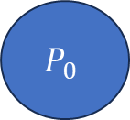
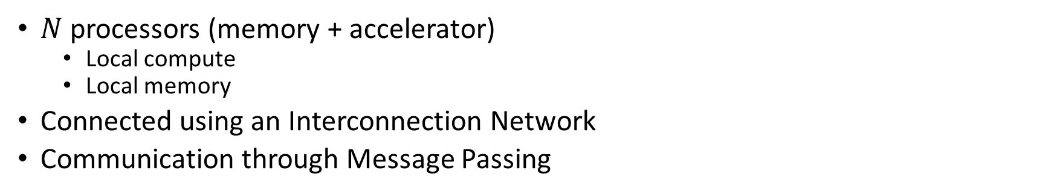
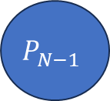
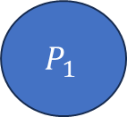
Cluster of Accelerators
$N$ processors (memory + accelerator)
Local compute
Local memory
Connected using an Interconnection Network
Communication through Message Passing
Interconnection Network
$$P_{0}$$
$$P_{1}$$
$$P_{N−1}$$
…

Slide 5
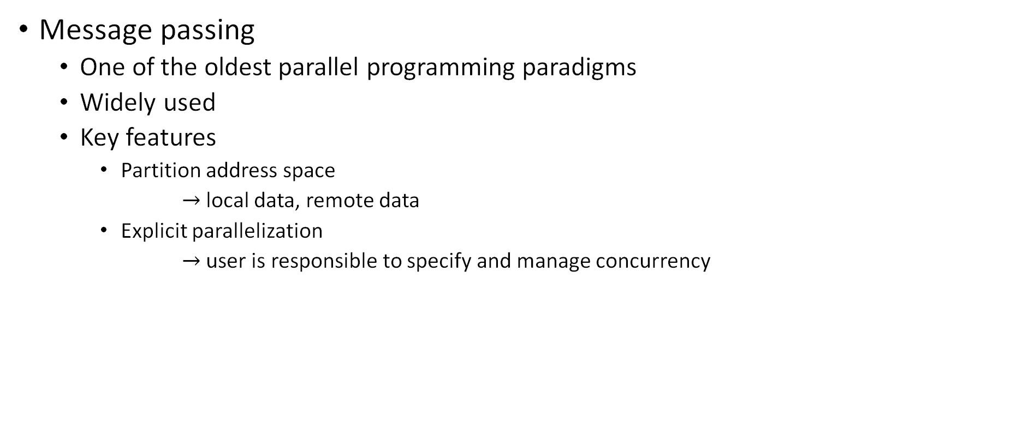
Message Passing Programming Model (1)
Message passing
One of the oldest parallel programming paradigms
Widely used
Key features
Partition address space
$→$ local data, remote data
Explicit parallelization
$→$ user is responsible to specify and manage concurrency

Slide 6
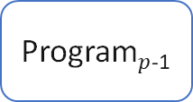
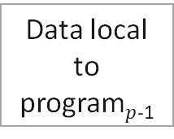
Message Passing Programming Model (2)
Explicit communication
Program₀
Program₁
Program$p$₋₁
……
Data local to program₀
Data local to program₁
Data local to program$p$₋₁
Communication - needs coordination among the communicating processes
Most Popular Framework – Message Passing Interface (MPI)

Slide 7
Message Passing Programming
How do we program clusters using Message Passing?
We need to specify the local computations that each processor will execute
We also need to specify at what time which pairs of processors will communicate and what data they will transfer to each other

Slide 8
Resources
Slides from University of Stuttgart - https://fs.hlrs.de/projects/par/par_prog_ws/pdf/mpi_3.1_rab.pdf
Covers all the important details of MPI (744 slides)
We will cover only enough for its application to AI

Slide 9



Communication Operations (1)
A pair of Send and Receive is used to implement a communication step
Processor $P_{0}$ sends size amount of data to Processor $P_{1}$
Processor $P_{1}$ receives size amount of data from Processor $P_{0}$
Needs to be symmetric: If not, will lead to hard to debug errors
$$P_{0}$$
Send ( sendbuf,
size,
dest )
$$P_{1}$$
Receive ( recvbuf,
size,
source )
data
size
Destination process ID
Source process ID

Slide 10
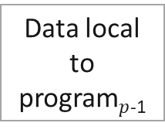
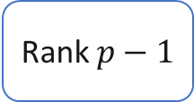
Communication Operations (2)
How do we identify processor IDs? Ranks
Rank 0
Rank 1
Rank $p−1$
……
Data local to program₀
Data local to program₁
Data local to program$p$₋₁

Slide 11
Communication Operations (3)
How do we identify processor IDs? Ranks
Collection of all the processors is called World
Rank 0
Rank 1
Rank $p−1$
……
Data local to program₀
Data local to program₁
Data local to program$p$₋₁

Slide 12
Communication Operations (4)
How do we identify processor IDs? Ranks
Each Processor in the World is assigned a unique ID called Rank
Rank 0
Rank 1
Rank $p−1$
……
Data local to program₀
Data local to program₁
Data local to program$p$₋₁

Slide 13
Communication Operations (5)
How do we identify processor IDs? Ranks
It is possible to create partitions of the world. We will not discuss in this class
Rank 0
Rank 1
Rank $p−1$
……
Data local to program₀
Data local to program₁
Data local to program$p$₋₁

Slide 14
Anatomy of an MPI Program
Each processor will run the exact same program
Actual instructions that get executed may vary depending upon the rank
MPI_Init(…)
MPI_Comm_rank(MPI_COMM_WORLD, &my_rank)
MPI_Comm_size(MPI_COMM_WORLD, &num_procs);
Do rank specific work
Mpiprogram.c

Slide 15
Anatomy of an MPI Program
MPI_Init(…)
MPI_Comm_rank(MPI_COMM_WORLD, &my_rank)
MPI_Comm_size(MPI_COMM_WORLD, &num_procs);
Do rank specific work
API to initialize the MPI framework

Slide 16
Anatomy of an MPI Program
MPI_Init(…)
MPI_Comm_rank(MPI_COMM_WORLD, &my_rank)
MPI_Comm_size(MPI_COMM_WORLD, &num_procs);
Do rank specific work
Obtain the rank of the process and the size of the world

Slide 17
Anatomy of an MPI Program
MPI_Init(…)
MPI_Comm_rank(MPI_COMM_WORLD, &my_rank)
MPI_Comm_size(MPI_COMM_WORLD, &num_procs);
Do rank specific work
Do work which is specific to the rank

Slide 18
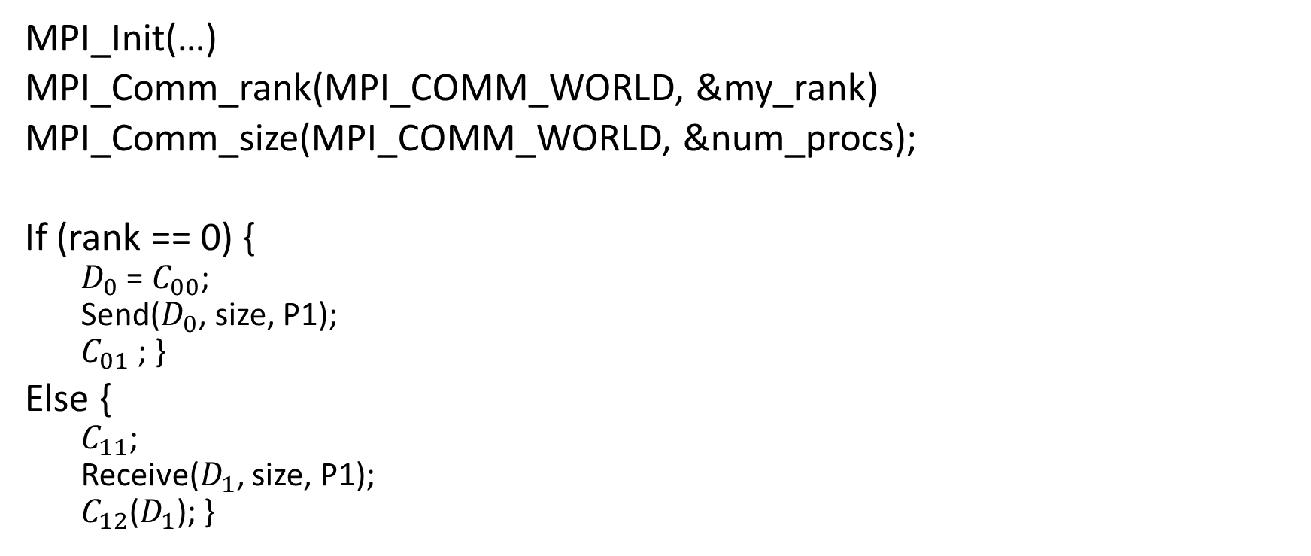
Inter-Process Communication (1)
MPI_Init(…)
MPI_Comm_rank(MPI_COMM_WORLD, &my_rank)
MPI_Comm_size(MPI_COMM_WORLD, &num_procs);
If (rank == 0) {
$D_{0}$ = $C_{00}$;
Send($D_{0}$, size, P1);
$C_{01}$ ; }
Else {
$C_{11}$;
Receive($D_{1}$, size, P1);
$C_{12}$($D_{1}$); }
Rank 0
Rank 1
Data local to program₀
Data local to program₁
Two processor world

Slide 19

Inter-Process Communication (2)
MPI_Init(…)
MPI_Comm_rank(MPI_COMM_WORLD, &my_rank)
MPI_Comm_size(MPI_COMM_WORLD, &num_procs);
If (rank == 0) {
$D_{0}$ = $C_{00}$;
Send($D_{0}$, size, P1);
$C_{01}$ ; }
Else {
$C_{11}$;
Receive($D_{1}$, size, P1);
$C_{12}$($D_{1}$); }
Rank 0
Rank 1
Data local to program₀
Data local to program₁
$P_{0}:$ Executes If portion

Slide 20

Inter-Process Communication (3)
MPI_Init(…)
MPI_Comm_rank(MPI_COMM_WORLD, &my_rank)
MPI_Comm_size(MPI_COMM_WORLD, &num_procs);
If (rank == 0) {
$D_{0}$ = $C_{00}$;
Send($D_{0}$, size, P1);
$C_{01}$ ; }
Else {
$C_{11}$;
Receive($D_{1}$, size, P1);
$C_{12}$($D_{1}$); }
Rank 0
Rank 1
Data local to program₀
Data local to program₁
$P_{1}:$ Executes Else portion

Slide 21


Inter-Process Communication (4)
P0:
$D_{0}$ = $C_{00}$;
Send($D_{0}$, size, P1);
$C_{01}$ ;
P1:
$C_{11}$;
Receive($D_{1}$, size, P1);
$C_{12}$($D_{1}$)
Compute operations
For better visualization, we will represent programs like this. This is equivalent to the previous program

Slide 22
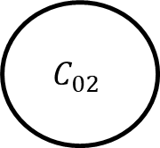
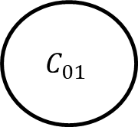
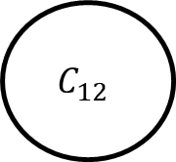
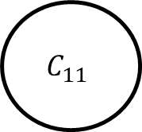
Inter-Process Communication (5)
P0
P1
$$C_{01}$$
$$C_{11}$$
Can you show the dependencies between these tasks?
$$C_{02}$$
$$C_{12}$$

Slide 23
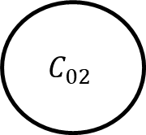
Inter-Process Communication (6)
P0
P1
$$C_{01}$$
$$C_{11}$$
$$C_{02}$$
$$C_{12}$$
Sequential Dependencies due to same processor

Slide 24
Inter-Process Communication (7)
P0
P1
$$C_{01}$$
$$C_{11}$$
$$C_{02}$$
$$C_{12}$$
Dependency across processors due to communication operation

Slide 25
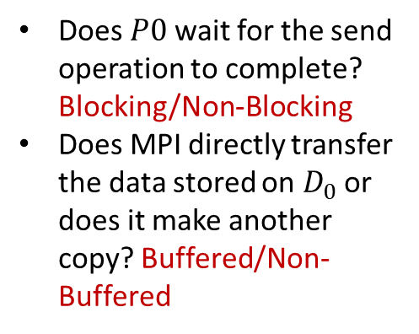
Blocking Semantics
P0:
$D_{0}$ = $C_{00}$;
Send($D_{0}$, size, P1);
$C_{01}$ ;
P1:
$C_{11}$;
Receive($D_{1}$, size, P1);
$C_{12}$($D_{1}$)
Does $P0$ wait for the send operation to complete? Blocking/Non-Blocking
Does MPI directly transfer the data stored on $D_{0}$ or does it make another copy? Buffered/Non-Buffered

Slide 26
Blocking Semantics
P0:
$D_{0}$ = $C_{00}$;
Send($D_{0}$, size, P1);
$C_{01}$ ;
P1:
$C_{11}$;
Receive($D_{1}$, size, P1);
$C_{12}$($D_{1}$)
Blocking Non-Buffered Send
Block sending process
Send request to receiving process
Wait for receiving process to acknowledge (matched receive operation)
Upon receiving acknowledgement, start the transfer
No buffers are used for data to be sent
Same happens at the receiver end

Slide 27
Blocking Send/Receive (1)
Sending
process
Receiving
process
Sending
process
Receiving
process
Sending
process
Receiving
process
Request
to send
Request
to send
Send
Request
to send
Idle
okay
to send
Send
Idle
okay
Recv.
Recv.
data
Send
okay
Recv.
data
data
Sender comes first;
idling at sender
(b) Sender and Receiver come at about the same time;
idling minimized
(c) Receiver comes first;
idling at Receiver

Slide 28
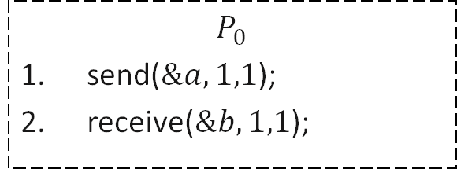
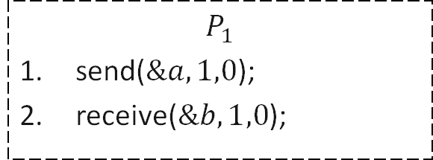
Blocking Send/Receive (2)
Issue #2: Deadlocks
blocked
$$P_{0}$$
send($\&a,1,1$);
receive($\&b,1,1$);
$$P_{1}$$
send($\&a,1,0$);
receive($\&b,1,0$);
Deadlocks are very easy in blocking protocols

Slide 29
Blocking Send/Receive (3)
Non-Block Buffered/Non-buffered addresses these issues, however, it complicates the implementation.
They are widely used, but we will not discuss here
You can refer to the Slides from University of Stuttgart - https://fs.hlrs.de/projects/par/par_prog_ws/pdf/mpi_3.1_rab.pdf

Slide 30
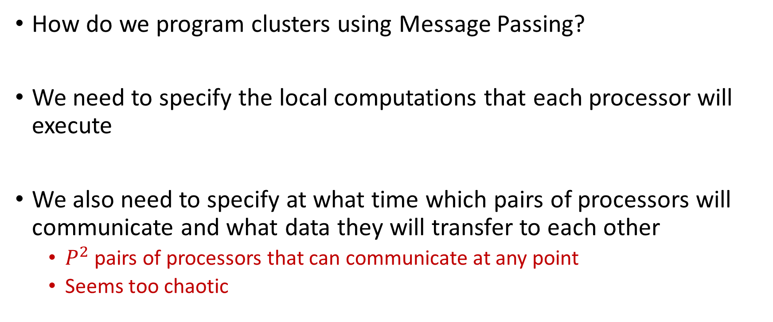
Message Passing Programming
How do we program clusters using Message Passing?
We need to specify the local computations that each processor will execute
We also need to specify at what time which pairs of processors will communicate and what data they will transfer to each other
$P^{2}$ pairs of processors that can communicate at any point
Seems too chaotic

Slide 31
Concurrency Models in Message Passing Programming
Bring some structure to the programming
Decide points in the program where processes will not communicate at all or when all processes communicate

Slide 32
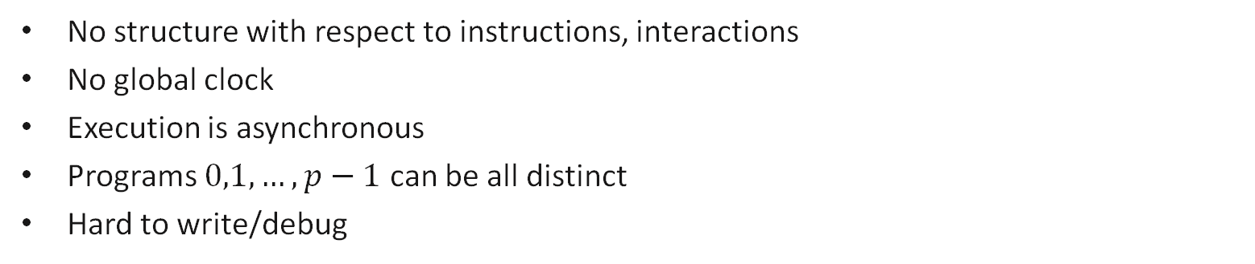
Message Passing Program (1)
Most General Model: Asynchronous
Program₀
Program₁
Program₂
S
S
R
……
R
R
S
R
S = send
R = receive
S
End
End
End
No structure with respect to instructions, interactions
No global clock
Execution is asynchronous
Programs $0,1,…, p−1$ can be all distinct
Hard to write/debug

Slide 33
Message Passing Program (2)
Bulk synchronous
Program₀
Program₁
Program₂
Program₃
Program₄
Computation phase
Communication phase
sync
Two phases to the Program
Computation Phase: Each process executes independently. No communication
Communication Phase: Processes communicate with each other (usually using group communication primitives – we will discuss in the next class)

Slide 34
Message Passing Program (2)
Bulk synchronous
Program₀
Program₁
Program₂
Program₃
Program₄
Computation phase
Communication phase
sync
Simplifies implementation by bringing in structure to the program
Communication doesn’t happen at random times, easier to debug issues
Using Group communication primitives further simplifies implementations
Widely use in Machine Learning Training

Slide 35
Message Passing Program (3)
SPMD (Single Program Multiple Data)
Code is same in all the processes except for initialization
Restrictive model, easy to write and debug
Easy to do performance analysis
Widely used in Machine Learning Training
Program₀
Program₁
Program₂
Program₃
Program₄
Program₄

Slide 36
Message Passing Program (3)
SPMD (Single Program Multiple Data)
BSP
Programs can be different
Explicit Barrier (synchronization) between Computation and Communication Phases
SPMD
Programs have to be same – different data
No explicit barrier needed (but maybe implied if using blocking send/receive)
Program₀
Program₁
Program₂
Program₃
Program₄
Program₄

Slide 37


Virtual Topology
Define the “connectivity pattern” of the processors
Helps us in developing more intuitive notions of message passing algorithms
Think of it as 1D versus 2D arrays. It will be hard to visualize matrix multiplication if we write algorithms using 1D arrays
$$0 1 p−1$$
…
…
$$0 1 p−1$$
…
1D Mesh
…
2D Mesh

Slide 38
Virtual Topology
Define the “connectivity pattern” of the processors
Helps us in developing more intuitive notions of message passing algorithms
(also has uses in optimizing the mapping of message passing algorithms onto real interconnection networks)
$$0 1 p−1$$
…
…
$$0 1 p−1$$
…
1D Mesh
…
2D Mesh

Slide 39
Message Passing Programming Paradigm
User Specifies the following
Concurrency Model (BSP, SPMD, None/Asynchronous)
Processes: The number of processes and the work performed for each process
Send, receive that enable data (we will only use blocking non-buffered semantics)
A virtual topology of the processes
We will discuss it at algorithmic level.
Skip initialization, rank calculation, etc.

Slide 40

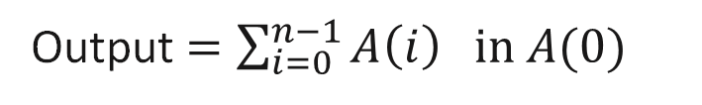

Adding Using Message Passing on 1D Mesh (1)
$$A(0)$$
Output $=\sum_{i=0}^{n−1}{A\left(i\right) in A(0)}$
$$A(n−1)$$

Slide 41

Adding Using Message Passing on 1D Mesh (1)
Concurrency Model? SPMD
How many Processors? $n$
What does each processor do?
Send/receive commands?
Virtual topology – 1D mesh

Slide 42

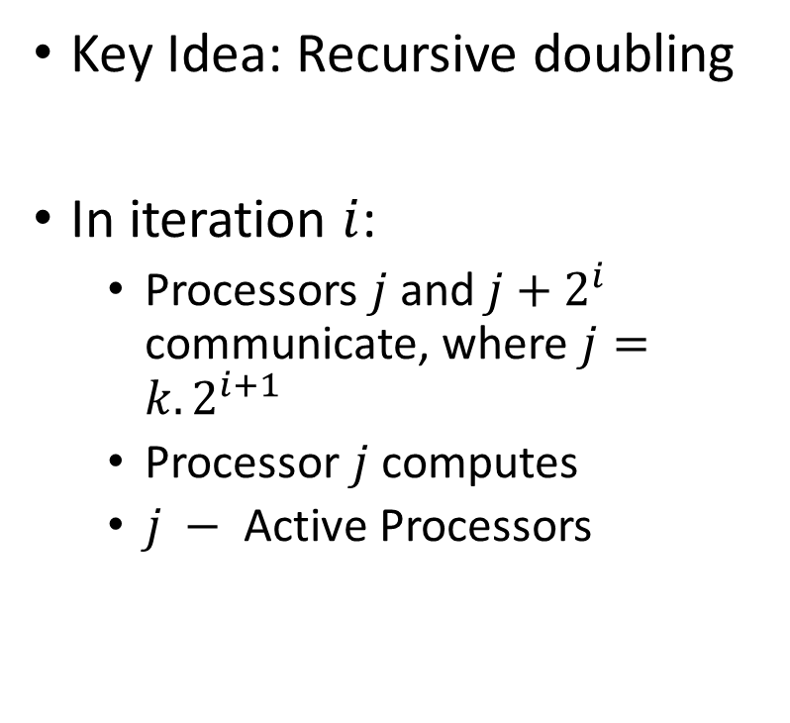

Adding Using Message Passing on 1D Mesh (2)
Key Idea: Recursive doubling
In iteration $i$:
Processors $j$ and $j+2^{i}$ communicate, where $j=k.2^{i+1}$
Processor $j$ computes
$j −$ Active Processors
$$A(0)$$
$$A(n−1)$$

Slide 43

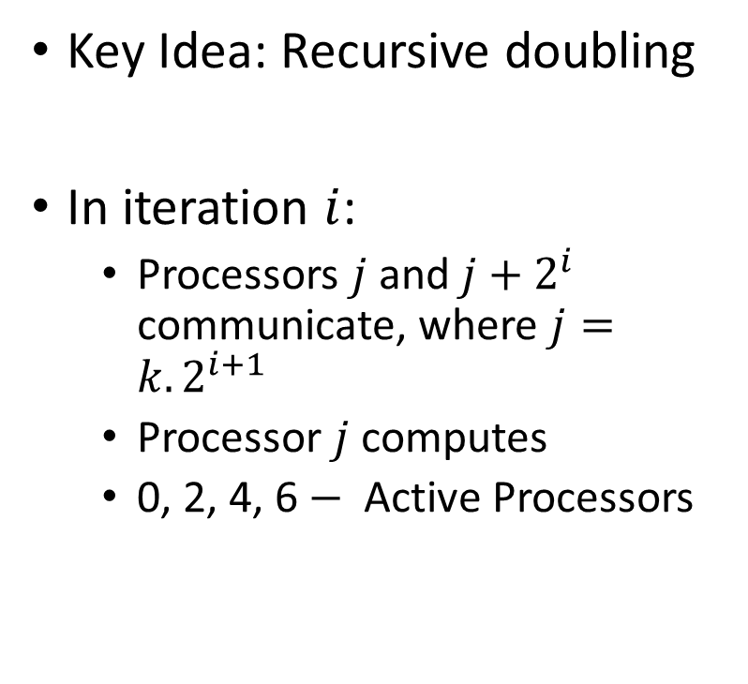
Adding Using Message Passing on 1D Mesh (3)
Key Idea: Recursive doubling
In iteration $i$:
Processors $j$ and $j+2^{i}$ communicate, where $j=k.2^{i+1}$
Processor $j$ computes
0, 2, 4, 6$−$ Active Processors
$$A(0)$$
$$A(n−1)$$
$$i=0$$

Slide 44

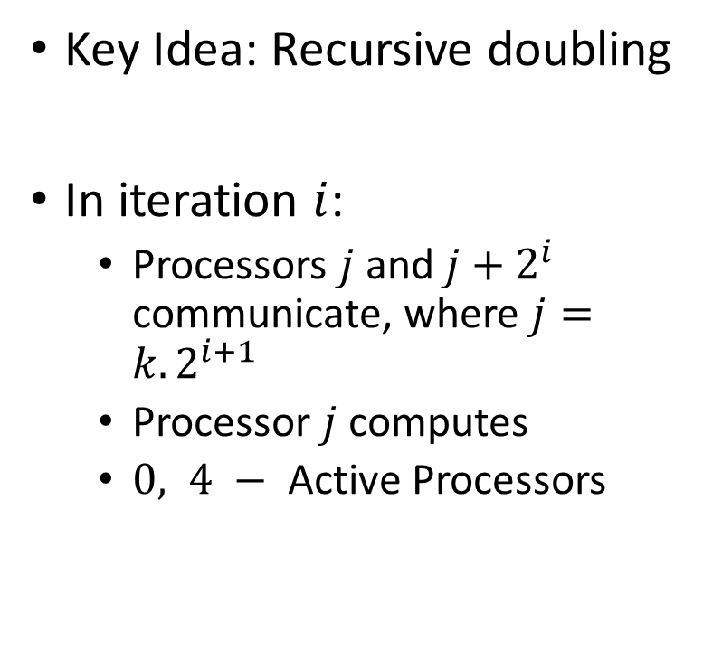
Adding Using Message Passing on 1D Mesh (4)
Key Idea: Recursive doubling
In iteration $i$:
Processors $j$ and $j+2^{i}$ communicate, where $j=k.2^{i+1}$
Processor $j$ computes
$0, 4 −$ Active Processors
$$A(0)$$
$$A(n−1)$$
$$i=1$$

Slide 45

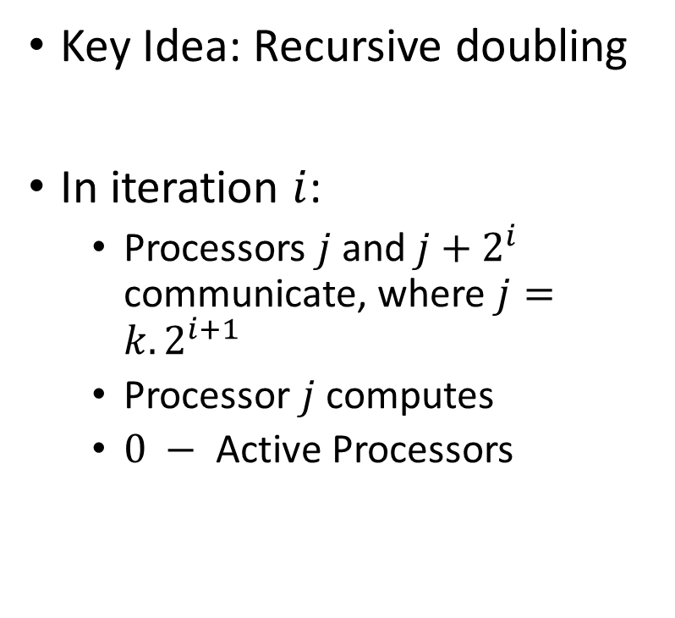
Adding Using Message Passing on 1D Mesh (5)
Key Idea: Recursive doubling
In iteration $i$:
Processors $j$ and $j+2^{i}$ communicate, where $j=k.2^{i+1}$
Processor $j$ computes
$0 −$ Active Processors
$$A(0)$$
$$A(n−1)$$
$$i=2$$

Slide 46
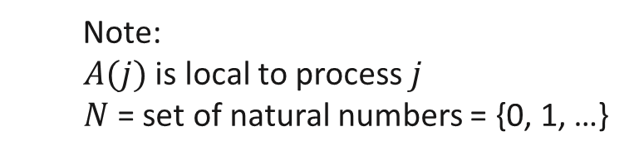


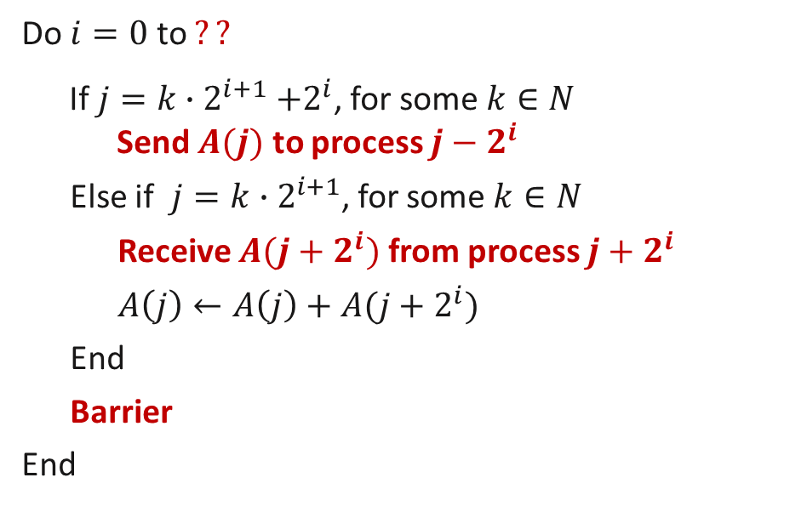
Adding Using Message Passing on 1D Mesh (6)
Message Passing Algorithm (SPMD model)
Program in process $j, 0≤j ≤n−1$
1.
Do $i=0$ to $??$
If $j=k{∙2}^{i+1}+2^{i}$, for some $k∈N$
Send $A(j)$ to process $j−2^{i}$
Else if $j=k∙2^{i+1}$, for some $k∈N$
Receive $A(j+2^{i})$ from process $j+2^{i}$
$A\left(j\right)←A\left(j\right)+A(j+2^{i})$
End
Barrier
End
2.
3.
$2^{i}$ distance communication
4.
5.
6.
7.
Note:
$A(j)$ is local to process $j$
$N$= set of natural numbers = {0, 1, …}
8.
9.

Slide 47
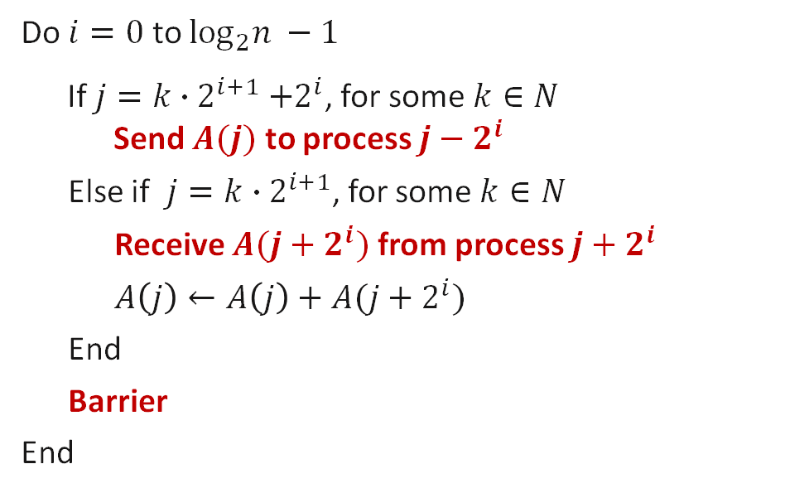
Adding Using Message Passing on 1D Mesh (6)
Message Passing Algorithm (SPMD model)
Program in process $j, 0≤j ≤n−1$
1.
Do $i=0$ to $\log_{2}n −1$
If $j=k{∙2}^{i+1}+2^{i}$, for some $k∈N$
Send $A(j)$ to process $j−2^{i}$
Else if $j=k∙2^{i+1}$, for some $k∈N$
Receive $A(j+2^{i})$ from process $j+2^{i}$
$A\left(j\right)←A\left(j\right)+A(j+2^{i})$
End
Barrier
End
2.
3.
$2^{i}$ distance communication
4.
5.
6.
7.
Note:
$A(j)$ is local to process $j$
$N$= set of natural numbers = {0, 1, …}
8.
9.

Slide 48
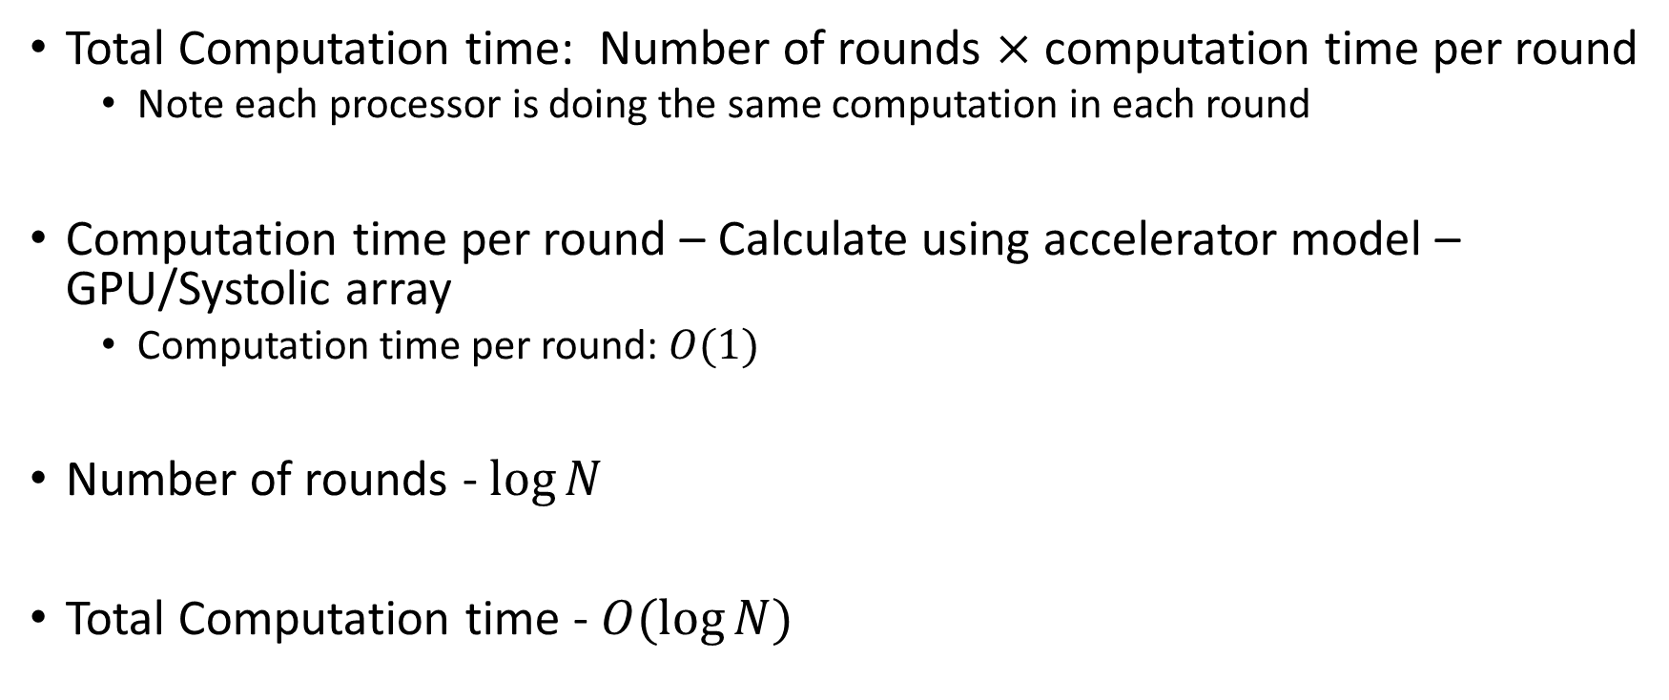
Performance Analysis (1)
Total Computation time: Number of rounds $×$ computation time per round
Note each processor is doing the same computation in each round
Computation time per round – Calculate using accelerator model – GPU/Systolic array
Computation time per round: $O(1)$
Number of rounds - $\log{N}$
Total Computation time - $O(\log{N})$

Slide 49
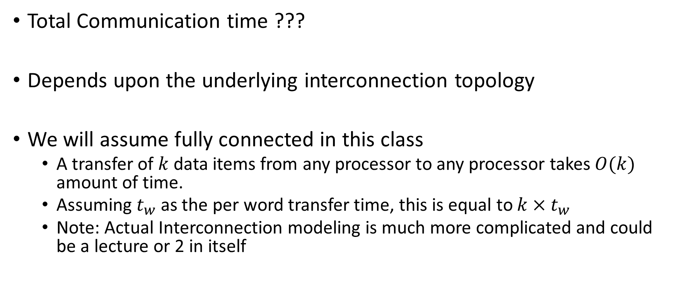
Performance Analysis (2)
Total Communication time ???
Depends upon the underlying interconnection topology
We will assume fully connected in this class
A transfer of $k$ data items from any processor to any processor takes $O(k)$ amount of time.
Assuming $t_{w}$ as the per word transfer time, this is equal to $k×t_{w}$
Note: Actual Interconnection modeling is much more complicated and could be a lecture or 2 in itself

Slide 50
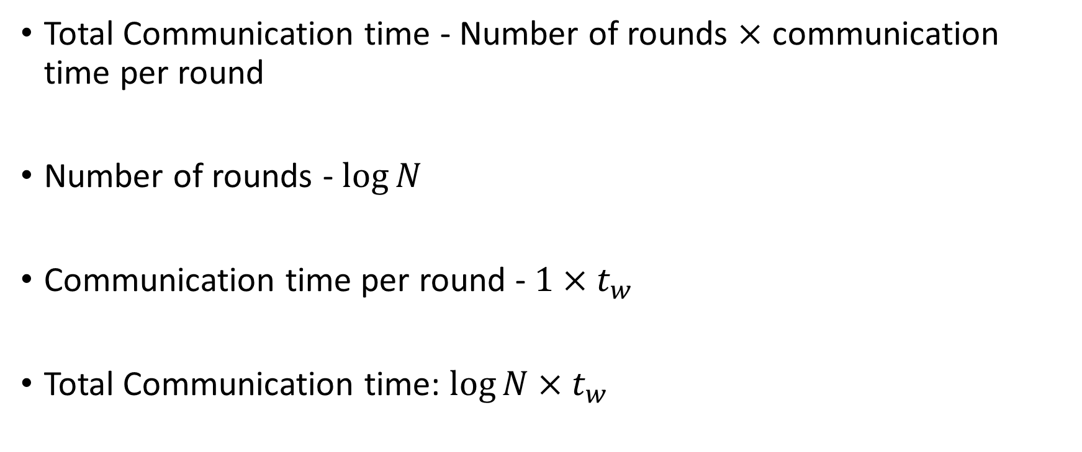
Performance Analysis (3)
Total Communication time - Number of rounds $×$ communication time per round
Number of rounds - $\log{N}$
Communication time per round - $1×t_{w}$
Total Communication time: $\log{N}×t_{w}$

Slide 51
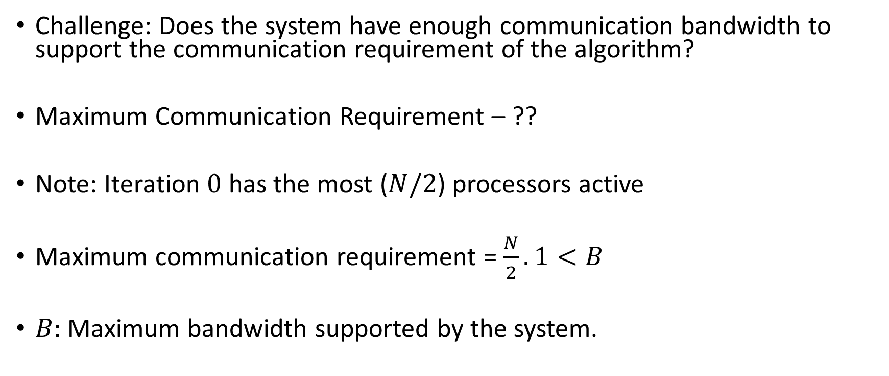
Performance Analysis (4)
Challenge: Does the system have enough communication bandwidth to support the communication requirement of the algorithm?
Maximum Communication Requirement – ??
Note: Iteration $0$ has the most ($N/2$) processors active
Maximum communication requirement = $\frac{N}{2}.1<B$
$B:$ Maximum bandwidth supported by the system.

Slide 52
Next Class
11/13 Lecture 21
Distributed Matrix Multiplication on a Cluster of Accelerators
Communication Primitives

Slide 53
Thank You
Questions?
Email: sanmukh.kuppannagari@case.edu

